Slide 1
Doctoral colloquium – DGfS 2021, Freiburg Workshop: Data wrangling & reproducible reports with tidyverse and R-Markdown
Welcome!

Slide 2
Schedule for today
9:00 – 9:40 | Welcome, introductions, housekeeping and organisation
9:40 – 11:00 | RMarkdown with Giulia
11:00 – 11:10 | Coffee break
11:10 – 12:10 | Tidyverse with Julia
12:10 – 13:00 | Lunch break
13:00 – 15:05 | Tidyverse with Kyla & Julia
15:05 – 15:20 | Coffee break
15:20 – 16:50 | More tidyverse and ggplot with Kyla & Julia
16:50 – 17:00 | Final remarks
From 19:30 | Networking & socialization in Gather Town

Slide 3
Get to know each other
Randomly assigned breakout rooms
Introduce yourself
What are you working on?
Which kinds of data are you working with?
What’s your experience with R, so far? What have been major success stories and roadblocks you encountered?

Slide 4
Housekeeping
Code of conduct
Following the R-Ladies code of conduct (https://rladies.org/code-of-conduct/):
Harassment-free space - anyone who violates rules will be removed!
If there’s an issue, message one of us co-hosts privately!
Recordings (to potentially be hosted on Youtube):
Only the teaching portions will be recorded (so feel free to ask questions in the question/exercise blocks!)
Please leave your video off in the teaching portions if you want to be 100% sure (but we would be happy to see you in between and only intend to include video of the speaker in final cuts)
Chat
Ask questions!
A co-teacher or moderator will read them out for the current instructor to answer (or answer them directly in the chat)

Slide 5
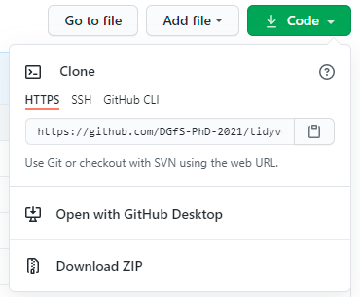
Data and workshop materials
Available on github
R-Markdown materials: https://github.com/DGfS-PhD-2021/R-markdown-course
Tidyverse materials: https://github.com/DGfS-PhD-2021/tidyverse-materials
To download the materials:
Download to your computer, then unzip each of the repositories

Slide 6
Networking & socialization in Gather Town
Access: https://gather.town/app/cr6ecv4qTJepyKy2/DGfS2021
Please don’t post this link or give it to anyone who’s not registered
Please use real first and last name when joining
Use Firefox or Chrome
If you're not familiar with Gather, here’s a short intro by Miriam Neuhausen: https://www.youtube.com/watch?v=Ndjw2i5M2x4

Slide 7
Thank you!
See you in Gathertown ☺

